Slide 1


Slide 2

Piloting Kean’s New General Education Foundation Course
Dr. Bridie Chapman
Dr. Jonathan Mercantini

Slide 3

What this Session Will Cover
ID 1500 Objectives
First Year Seminar (FYS) Background
Kean’s New FYS Pilot Course Goals
Timeline and Key Dates
How to submit a proposal (if you are interested)

Slide 4
Objectives of ID 1500
Encourage students to find satisfaction and enjoyment in reading and thinking critically about what they read
Help students develop critical reading skills that can be transferable to various genres and texts (essays, blogs, new articles, peer reviewed articles) in order to prepare them for the various materials they will be reading in college
Introduce how to find, cite, and read various source materials
Counts as GE Humanities Distribution or Free Elective

Slide 5

First Year Experience Courses
Harvard
University of Richmond
The College of New Jersey

Slide 6
Goals of First Year Seminar
Interdisciplinary Inquiry
Introduce students to college-level academic work
Prepare students for more advanced readings
Reinforce students’ awareness of different sources
Build community through a small class experience

Slide 7
Timeline and Key Dates
2/14/2020: Submissions of Pilot Proposals
2/28/2020: Decision Day for Proposals
Summer 2020: Training for FYS Pilots
Fall 2020: Check-in for FYS Pilots
January 2021: PDD Presentation on the FYS

Slide 8
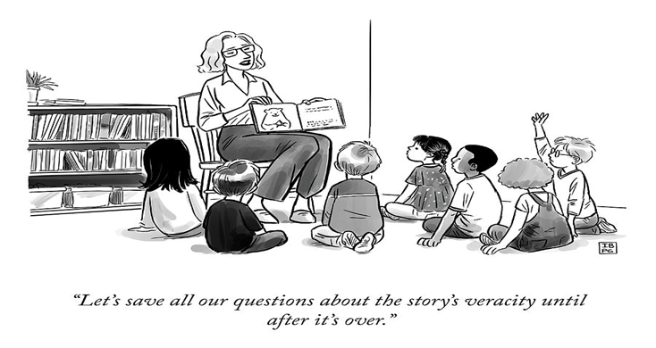

Slide 9
Course Design
Small Classes (16 student Cap)
Interdisciplinary
Reading Based
Anchor Text
Supplemental Texts
Tenured/Tenure-Track/Lecturer/Staff Experts

Slide 10
Expectations for Faculty
Course will be In-Load for Faculty
Training -- Workshop(s) on First Year Seminar
June 22, 2020 Completed Syllabus submitted
Fall 2020 - Teaching the Course
Surveys of Students
October 2020 - Participants meeting on successes and challenges
January 2021 - Participating in PDD on your experience

Slide 11
Proposal Components
Name/Program/Title
Topic and Course Title
Description (specify how this will be interdisciplinary)
Anchor Text
Supplemental Texts
Active Learning Strategies

Slide 12
Review Committee
Dr. Bridie Chapman
Dr. Jonathan Mercantini
TBD…

Slide 13
Submission Portal
https://forms.gle/fewqgRYYqCg6hnhb7

