Slide 1
Ellucian Distributed Financials Part I – Rules and Procedures for Procurement
Faruque Chowdhury, Associate Vice President
Yelena Khaytin, Managing Assistant Director
Judy Pavese, Managing Administrative Assistant

Slide 2
Speakers
Jennifer Strahan, Budget Office
Stacy Auer, University Procurement and Business Services
Stephany Villalta, Office of the CFO
Jessica Bances, General Accounting
Ada Rodriguez, General Accounting

Slide 3
Procure to Pay
University is currently involved in the implementation of a Procure to Pay program (P2P).

Slide 4
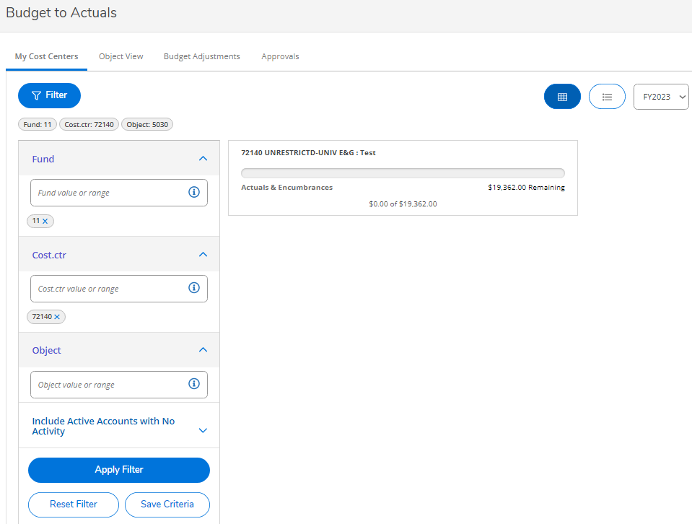
Budget Self Service – How to view a cost center?
How to View a Cost Center –Login to Self Service
Select Financial Management Overview
Select Budget to Actuals
Click the My Cost Centers tab
Enter your Fund
Enter you Cost Center
Apply Filter
You can choose multiple fiscal years to view
Click to view the details of the cost center

Slide 5
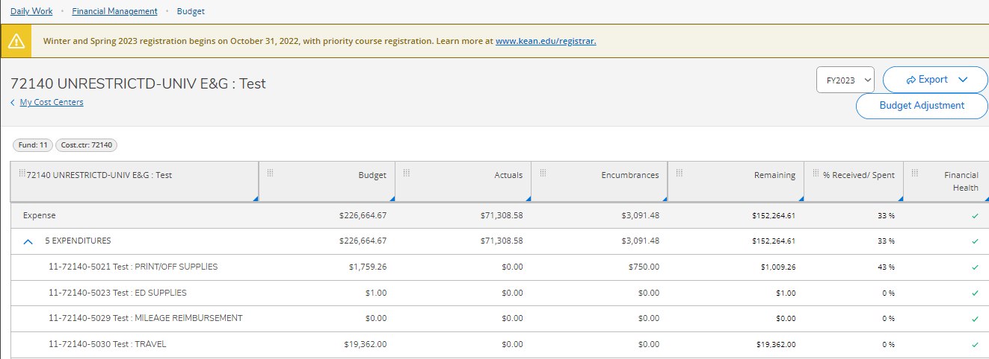
Budget Self Service – How to view a cost center?
You can drill to see this PO holding the encumbrance
Clicking into the cost center you can view by object, and drill down to PO and requisition.

Slide 6
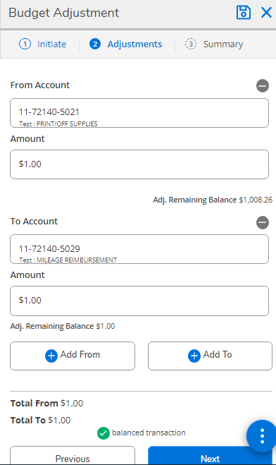
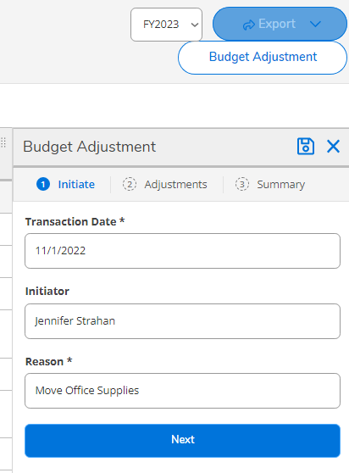
Budget Self Service – Budget Adjustment
How to Request a Budget Adjustment
Once you are in your cost center, select Budget Adjustment
Add Reason for Budget Adjustment
Select Next
Drag the account to move funds from
Enter the Amount
Drag the account to move funds to
Enter the Amount
Click Next
Click Submit
Budget Adjustments Not Allowed in Self-service
Salary Accounts 51XX
Between Cost Centers
Grants

Slide 7
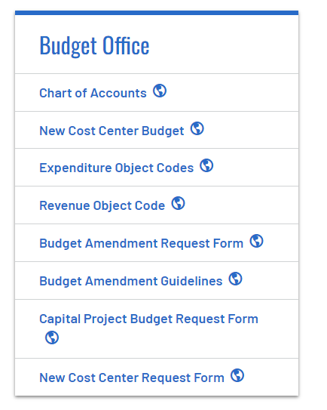
Budget Self Service – Helpful Links
Self Service Login Link – https://selfservice.kean.edu/Student
Budget Office Website Links:
Chart of Accounts – with descriptions of use
New Cost Center Budget Set-up
Budget Amendment
New Cost Center Request Form

Slide 8
New Purchase Limits & Bid Thresholds
1. Up to $25,000.00: No competitive quotes required.
2. $25,000.01 – $100,000.00: Three (3) written quotes are required.
Quotes are not required for Professional Service Agreements or for other goods and services
Departments must submit quotes along with the Competitive Quote Form.
3. Over Bid Threshold University Wide: Formal advertised bid will be coordinated through the UPBS or a bid waiver will be required.
*All totals are annual University-wide aggregate values

Slide 9
Purchasing Timeline: $100,000.00 or less.
Obtain quotes. Three required for most purchases between $25,000.01 and $100,000.00.
Check your Budget.
Submit requisition in the Ellucian System with supporting documentation (i.e. W-9, agreement, quote, NJ BRC, etc.).
Obtain required approvals.
No purchase will be permitted without a Purchase Order (PO), including reimbursement.
Purchase Order approved and sent to the requesting department.
Purchase may be made.
Once goods/services are delivered, department accepts Purchase Order in PORC.
Invoice sent to Accounts Payable so that the vendor can be paid.

Slide 10
Purchases Above $100,000.00
Public Advertisement Required (Bid): The formal submissions in response to public advertisement as part of a fair and open process.
Exceptions:
Board of Trustees Waiver: Resolution by Kean BOT, Certain Exceptions
Contracts with Other Government Agencies: Resolution by Kean BOT Required.
State Contract Purchases
Cooperative Purchases
General Services Administration (GSA) Schedules

Slide 11
Bid Process re: Purchases Above $100,000.00
Bidding threshold for goods and services is $100,000.01 or more.
Threshold values are cumulative.
If threshold is met, a publicly advertised bid, typically called a Request for Proposal (RFP), must be issued by University Procurement and Business Services, unless there is a statutorily acceptable exception to public bidding.
Contact University Procurement and Business Services.
Lead time of 10 to 12 weeks to complete the bidding process.
Drafting the RFP: We’ll need feedback on 1) scope of work, 2) evaluation criteria, and 3) pricing.
Advertise the RFP & Bid Opening time, manner and place. See ebidding.kean.edu.
Inquiry Deadline & Addendum: We may need your feedback with bidders’ inquiries.
Bid Opening: Then we review & evaluate bidders’ proposals. Contracts are awarded to bidder(s) whose proposal is most advantageous to the University.
Notice of Award is sent to successful bidder(s).

Slide 12
Sample W-9 Form
Notes:
Bid threshold to $100,000
New exceptions to bidding: (1) the rental of space and equipment used for graduation and other events and ceremonies; (2) banking and investment services; (3) energy supply, such as electric and gas, from a third-party supplier; (4) hazardous waste collection and disposal services; (5) supplies and services for the administration of study abroad or remote programs; (6) transportation services; (7) vehicle maintenance; (8) vending services; and (8) medical testing.
Exemption for reverse auction for the purchase of utilities and other commodities.
Disqualification of bidders with whom the University has had a negative experience.
The bill provides that the governing board of a public institution of higher education may by resolution establish a cooperative pricing system with the governing boards of other public institutions of higher education

Slide 13
Increased Threshold for NJ Business Registration Certificate Requirement
All contractors and subcontractors must still provide proof of a New Jersey Business Registration Certificate(NJBRC) when seeking to do business with Kean University.
Vendors must provide a NJBRC before a purchase order is approved if the Vendor exceeds *$15,000.00 in business in a fiscal year.
*This value is cumulative, meaning that if multiple departments utilize the same vendor in a given fiscal year, the value of all purchase orders will be aggregated to determine if a threshold is met.

Slide 14
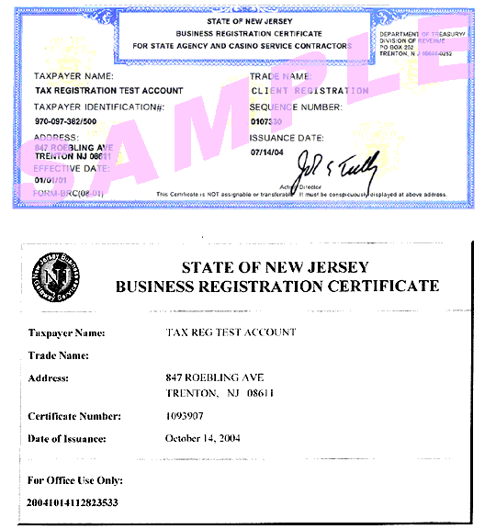
Sample NJ Business Registration Certificate (NJ BRC)
Notes:
Bid threshold to $100,000
New exceptions to bidding: (1) the rental of space and equipment used for graduation and other events and ceremonies; (2) banking and investment services; (3) energy supply, such as electric and gas, from a third-party supplier; (4) hazardous waste collection and disposal services; (5) supplies and services for the administration of study abroad or remote programs; (6) transportation services; (7) vehicle maintenance; (8) vending services; and (8) medical testing.
Exemption for reverse auction for the purchase of utilities and other commodities.
Disqualification of bidders with whom the University has had a negative experience.
The bill provides that the governing board of a public institution of higher education may by resolution establish a cooperative pricing system with the governing boards of other public institutions of higher education

Slide 15
Amazon Business
Interested department(s) must email Faruque Chowdhury fchowdhu@kean.edu for authorization; cc Yelena Khaytin ykhaytin@kean.edu
One account access per Department/Unit; case-by-case basis approval
OCIS sends an invite once approved by UPBS
Certain categories are prohibited; certain categories are restricted
PPT is available for end users with reference help to navigate purchase process
NOTE: Must fully submit order cart for review and approval

Slide 16
Amazon Business (cont.)
Procurement will notify requestor once order is approved
Do Not Enter a requisition until approval email is received
Enter requisition and approve within two (2) business days in Ellucian
Items in cart are available for only seven (7) calendar days
Order will be released only once PO is issued
Once items are received, inspect for accuracy, damage, etc.
When invoice is sent, be sure to accept in PORC

Slide 17
Amazon Business (cont.)
Restricted Categories:
Food
Drinks
Non-Prime items
Computers/Electronics
Health and Beauty
Appliances
Clothing/Apparel
Personal Care Products
Home and Kitchen (tablecloths, cutlery, cups, etc.)
Pet and Plant
Tools/Automotive
Communication Devices
And many more

Slide 18
What are Confirming Orders?
A “Confirming Order” is any purchase order approved and issued by University Purchasing & Business Services after the requesting Department has already made the purchase.
By rule, a Confirming Order is an unauthorized purchase.
Confirming Orders are problematic because the goods or services are purchased before the Department has permission to buy.
Confirming Orders bypass the University’s procurement process.

Slide 19
Confirming Orders: Background
Kean University was audited by the Office of the State Auditor in 2016.
State Auditor found unacceptable use of “Confirming Orders”. University pledged to reduce the use of Confirming Orders moving forward.
In March of 2022, as part of Kean University’s urban research university designation, the Kean Board of Trustees directed CFO Andrew Brannen to adopt “standard operating rules and procedures” pertaining to the purchase of all equipment, materials, supplies and services.
On March 24, 2022, CFO announced new standard operating rules and procedures, including rules governing Confirming Orders. New procedures were effective immediately.
Notes:
Bid threshold to $100,000
New exceptions to bidding: (1) the rental of space and equipment used for graduation and other events and ceremonies; (2) banking and investment services; (3) energy supply, such as electric and gas, from a third-party supplier; (4) hazardous waste collection and disposal services; (5) supplies and services for the administration of study abroad or remote programs; (6) transportation services; (7) vehicle maintenance; (8) vending services; and (8) medical testing.
Exemption for reverse auction for the purchase of utilities and other commodities.
Disqualification of bidders with whom the University has had a negative experience.
The bill provides that the governing board of a public institution of higher education may by resolution establish a cooperative pricing system with the governing boards of other public institutions of higher education

Slide 20
Confirming Orders: Approval Process
Confirming orders must be avoided, but there is a process in place for review and possible approval.
Confirming Orders must be requested in writing by the Senior Vice President in charge of the Department that made the unauthorized purchase to the Chief Financial Officer with a cc to Stephany Villalta.
Approval of confirming orders are at the CFO’s discretion.
Employees submitting confirming orders may also be subject to disciplinary action in accordance with applicable policies for violations.

Slide 21
What is a Contract?
A binding legal agreement between Kean and a vendor.
Includes pricing, terms of service, and other contractual obligations mutually agreed to by the parties.
Governs the performance.
For the purposes of these rules and procedures, this definition does not include agreements of employment.
Kean University rules and procedures require contracts to be in writing.

Slide 22
Who can Sign a Contract for Kean?
Contracts and agreements for the purchase of equipment, materials, supplies and services require:
Review and approval by the UPBS/University Counsel.
Signature:
President
Chief Financial Officer
Associate Vice President of University Procurement & Business Services

Slide 23
Signing Authority (Cont.)
Other Types of Contracts:
Affiliation agreements
Articulation agreements
Memoranda of agreement/understanding
Acceptance of grant funds
Research agreements or other similar agreements
Require review and approval by the Office of University Counsel.
May be signed by:
President
Chief of Staff
Chief Financial Officer
Senior Vice Presidents or their designees.

Slide 24
Contract Length
The maximum contract term for University contracts is five (5) years. A longer term may be permitted with the approval of the CFO or their designee if in the University’s best interest.

Slide 25
https://www.kean.edu/offices/university-procurement-and-business-services/purchasing-operating-rules-procedures

Slide 26
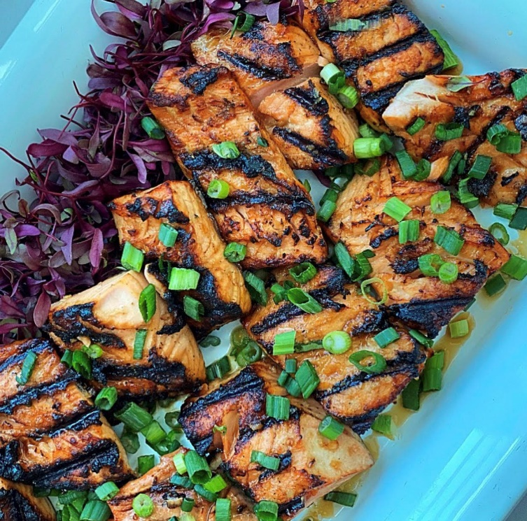
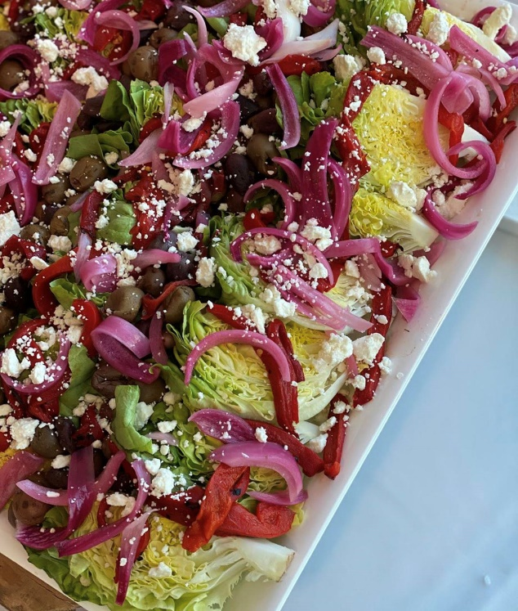
Gourmet Dining Catering Requests

Slide 27
Formstack Approval (for Academic and Non-Academic Units)
Gourmet Dining is the University’s food vendor
You must include a quote through https://www.kean.edu/offices/gourmet-dining prior to completing food request through Formstack for accurate cost. This quote must be attached to your request.
The requisition cannot be entered before your request is approved in Formstack.
For Academic Units – requisition approvers must include abrannen in addition to dbirdsell for all academic units
Once approved, you will receive a response from the Budget Office that funds are available; at that point, you can enter a requisition.
Must include the date and name of the event in requisition description

Slide 28
Formstack Approval (cont): (for Academic and Non-Academic Units)
Food requests must have exact dollar amount of the order; estimates are not acceptable and will be denied.
Food requests with Gourmet Dining cannot be placed until Purchase Order number is received. You must go back into your quote and change form of payment to the particular PO number.
Once purchase order is issued you cannot add to the existing PO.
Departments authorized to use Blanket Purchase Order (BPO) are still required to complete a Formstack for each event and include BPO number in the Comments.

Slide 29
Non-Gourmet Dining Catering requests
For all off-site events, including conferences, events and meetings
Must complete approval request through Formstack for all food requests
Link is found on University Procurement and Business Services website: https://www.kean.edu/offices/university-procurement-and-business-services/food-request
Attach quote/estimate to Formstack request
Provide pertinent event information: who, what, where, how many, etc.
Office of Chief Financial Officer and Budget Office will either approve or deny the request

Slide 30
Ellucian Distributed Financials Part II – How to Enter a Requisition

Slide 31
University
Procurement
REQUISITIONS
PURCHASE ORDERS
Materiel Services
Requesting Department
PURCHASE ORDER RECEIVING
RECEIVING
PURCHASE ORDER RECEIVING
VOUCHERS
CHECKS
General Accounting
https://testui.kean.edu/UI/Home/index.html

Slide 32
Ellucian Distributed Financials
REQ MAINTENANCE
REQM: Requisition Maintenance
APPW: Approval Password Maintenance
APRN: Approvals Needed
PORC: Purchase Order Receiving
EX: Exit
LO: Logout
INQUIRY
RINQ: Requisition Inquiry
PINQ: Purchase Order Inquiry
DINQ: Procurement Dates Inquiry
BINQ: Blanket PO Inquiry
PORL: Purchase Order Receiving
List

Slide 33
Requisition Maintenance
The REQM screen is the “Cover Page” for this procedure. Requisitions are initiated here. Most of the general information about the future order such as the vendor, shipping information, etc. is recorded here.
Enter “A” to add and then press Enter, press Enter again to automatically assign a number. Fiscal Year Falls Beyond Date: ALWAYS Enter “Y” to accept date.
SPECIAL NOTE:
If you have forgotten your requisition number, try “;IN Last Name,First Name” at the Lookup prompt. This will display a list of the requisitions that you have entered into the system. Click on the one you wish to work on.
* To DELETE click on the Line Item, then hit CTRL+ALT+D

Slide 34
Requisition Maintenance Information
Requisition Date: automatically defaults today’s date. Press Enter to continue.
Initiator: Enter code assigned by OCIS (or type Last Name).
Desired Date: Press Enter.
Maintenance Date: Automatically skips Requisition Amount.
Vendor ID: Press Enter to skip.
Name: Type Vendor name.
C or P: ALWAYS type (C) for corporation.
Address: Type Vendor address.
*CSZ: When you type the zip code, the full CITY STATE ZIP will appear.
Country: If the Vendor is in another Country, type “…” to select Country.
Currency: Press Enter to skip.
Ship To: Automatically defaults to CR.
Ship Via: Press Enter to skip.
Types: Press Enter to skip.
*Note: If incorrect City appears, you must type in manually.

Slide 35
Requisition Maintenance Information (cont.)
FOB: Press Enter to skip.
Commodity: Automatically skips.
Line Items: Details to RQIM. Please click on to enter a detailed description.
Approvals: Approval Authorization Screen (APRV). See Next Slide for Details.
Buyer: Press Enter to skip.
Expire Date: Press Enter to skip.
AP Type: Press Enter to skip.
Invn Store: Press Enter to skip.
Printed Comments: ALWAYS type the requesting department.
Comments: Type comments here such as Blanket Purchase Order (BPO), Confirming Order (CO). You can also type any other comments here. If not, press Enter to skip.
Priority: Enter A if you are emailing attachments to University Procurement (i.e., quotes). If not, press Enter to skip.
Requisition Done: After entering line items via RQIM, enter N if not finished. Or enter Y if finished. Write the requisition number. There will be notes in Comments to remind you.
SPECIAL NOTE:
Your Requisition WILL NOT be converted into a Purchase Order until all attachments are received.
BEFORE calling University Procurement for the status of your requisitions, please check STATUS and also check in COMMENTS.

Slide 36
Approval Authorization (APRV)
The APRV screen allows the initiator of the requisition to set up the approval stream for the specific requisition. Also, it can be used to assign an approval directly on this screen.
Approvals: If the approvals were given in REQM, this column would be filled in with the date it was approved. The date will automatically fill in with the current date.
Next Approvals: This is where the initiator sets up the approval stream. The “Next Approvals” field becomes blank once the approval has been given. Then it shifts over to the Approvals column.
SPECIAL NOTE:
Please confirm that everyone listed in the approval stream has access and approval authority.
This screen can be used to give an approval to a specific requisition.

Slide 37
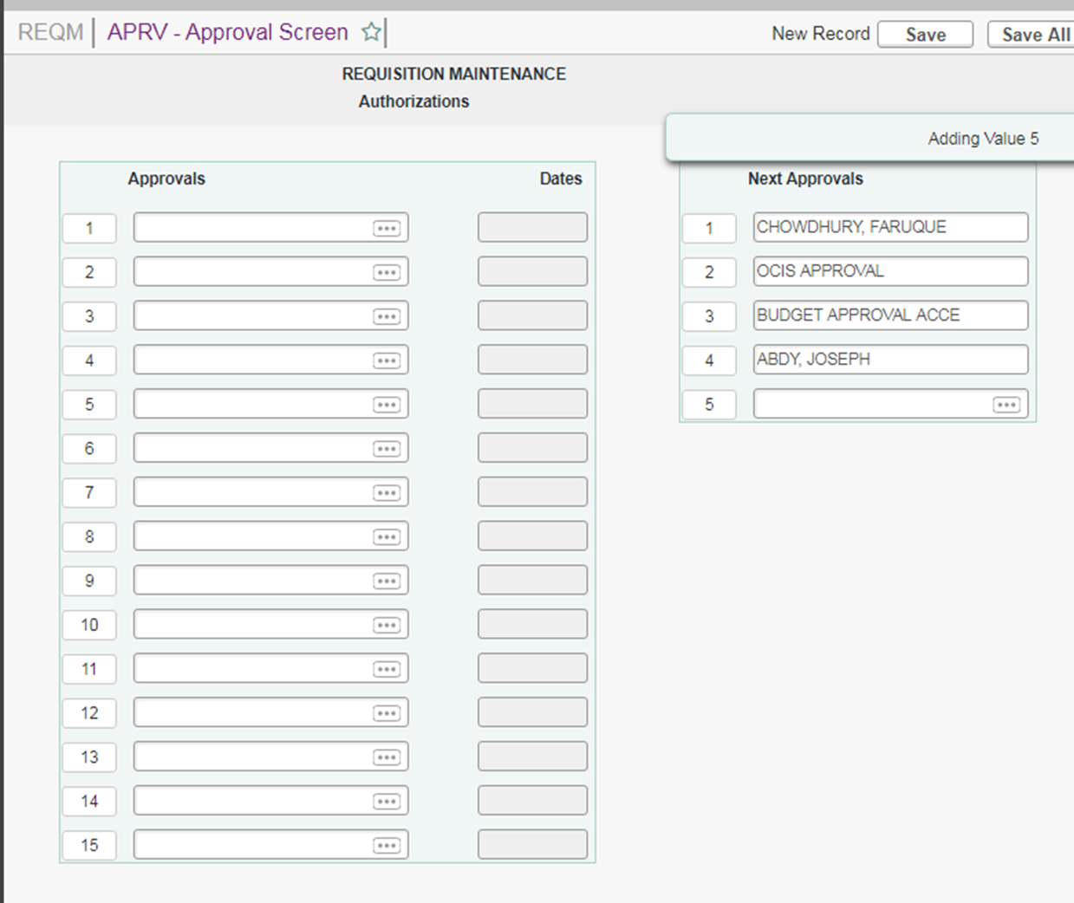

Slide 38
Requisition Item List (RQIL)
The RQIL Screen is a “Summary Page” which will automatically generate a list of the items to be purchased. The list will be empty when you first access the screen, but it will be automatically populated by Colleague. The RQIL screen lets you verify that data was entered correctly, then returns you to the REQM screen to finish the requisition process.
To order items via this requisition, Press DETAIL to RQIM
SPECIAL NOTE:
To DELETE a Line Item, click on the Line Item, then click Delete, then click Delete All, then click Save, then click Update.

Slide 39
Requisition Item Maintenance (RQIM)
The RQIM screen is a “Line Detail Page” where you enter description, price, quantity of an item and the general ledger account to which the cost of the item will be charged.

Slide 40
Requisition Item Maintenance (RQIM)
Vendor Name: Automatically defaults.
Commodity: Automatically skips.
Stock No: Automatically skips.
Description: Enter Item. Be specific. Use multiple lines if needed, include Item No., Date of Service, etc.
Est Price: Automatically formats data.
Quantity: Enter quantity. DO NOT enter a zero.
Unit of Issue: Enter “…” for dropdown list.
Trade Discount Amount: Automatically skips.
Trade Discount & Extended Price: Automatically skips.
Work Order/Type: Press Enter to skip.
Tax Codes: Press Enter to skip.
* GL Account No: This is Mandatory. You must obtain GL Account No. from the Budget Department. Use only one GL Account No.:
GL Account: Fund Cost Center Object Code
XX XXXXX XXXX
SPECIAL NOTE:
GL Funds Availability will automatically appear on right hand corner of the screen. If GL account number is the same for subsequent line items, use the @ sign as a shortcut for data entry.
To DELETE a GL Account Number, click SAVE, then press Ctrl+Alt+D

Slide 41
Approvals Needed (APRN)
The APRN screen lists the requisitions that need approval from a specific person. When you enter an approval ID, the screen lists all the requisitions (if any) that need approval from a specific person.
Enter your approval ID (Login ID)
APRN:
ID - The requisition number that needs approval will appear
Date - The date that the requisition was created automatically appears
Net - The net amount of the requisition items will appear
Priority - if the requisition was flagged with an “A” (for attachments) in the field “PRIORITY” in the REQM screen, the “A” will appear here
Appr - No, if approvals were not given
- Yes, if approvals were given

Slide 42
Requisition Inquiry Screen (RINQ)
The RINQ screen is a summary of all information on the requisition such as date, vendor name and descriptive information. All users have the ability to check the status of a requisition here.
Status:
In Progress - The initiator has saved the requisition, but has answered “No” “Requisition Done” in REQM.
Not Approved - The requisition is in the approval stream but has not received all the necessary approvals yet. To check approvals go to REQM Screen, scroll down to Approvals, Detail to APRV (Approval Screen).
Outstanding - The requisition has been approved, but a purchase order has not yet been generated. Be sure to look in Comments for any communication from Procurement (i.e. Need W-9, Need Quote)

Slide 43
Purchase Order Inquiry (PINQ)
The PINQ screen allows you to view information on a purchase order such as the vendor and detailed information concerning line items.
STATUS CODES:
PO Status:
A - Accepted I - Invoiced P - Paid
B - Backordered O - Outstanding R - Reconciled
C - Closed V - Void
SPECIAL NOTES:
You cannot change any information on this screen.
PLEASE MONITOR YOUR REQUISITION AND YOUR PURCHASE ORDER

Slide 44
Blanket Purchase Order Inquiry (BINQ)
The BINQ screen allows you to view information about a Blanket Purchase Order (BPO)
You cannot change any information on this screen
PLEASE MONITOR YOUR BPO

Slide 45
PO vs BPO
PURCHASE ORDER (“PO”)
BLANKET PURCHASE ORDER (“BPO”)
One time purchase
Multiple line items or single line item
Ongoing purchase
Only one line item
CANNOT be used to purchase equipment
CANNOT be used to purchase furniture

Slide 46
Purchase Order Receiving (PORC)
STOP
The PORC screen is used to receive all goods and services.
Date Received: Enter the exact date the goods were received
Packing Slip No: Enter the packing slip number or type “None”
Arrived Via: Press Enter to skip
Description: To enter a specific “Quantity Accepted”, press Enter. Then, enter the exact quantity under the Accepted column or you can press Enter to go on to the next item
Received By: Automatically defaults to user ID
Accept all Items: Enter Y to accept all items. DO NOT enter Y at this point for partial acceptance
SPECIAL NOTE: If ALL line items were received, then you may proceed to #6. Enter Y to Accept All items

Slide 47
General Accounting - AP
Major areas of responsibility include but are not limited to:
Auditing, vouching and paying invoices against a Purchase Order or Blanket Purchase Order
Auditing the expense within University Policy guidelines e.g. Travel policy
Ensuring the person approving payment has signing authority, for example invoices over $100,000 need VP approval
Processing vendor check runs in a timely and accurate manner (every Thursday)
Work closely with partner Wells Fargo for payment processing and vendor maintenance

Slide 48
Check run process
INVOICE
Matching Po and Invoice
CHECK APPROVALS
AP Supervisor
Director
BANK
Process
Check file is sent to the bank
WF will cut and mail checks
Check process
Associate Director
Voucher
WF will pay based on vendor enrollment ACH, CC or paper check

Slide 49
Invoices
Document required for payment by Accounts Payable
Must be the original document(PDF accepted by e-mail)
AP can’t process payment on a quote or confirmation order
To expedite payment please submit all invoices to acctspay@kean.edu with a copy of your purchase order
University payment policy is 30 days from date of invoice or date of service is rendered; policy written on the back of the PO
Payments are processed to vendors every Thursday
The invoice number should be unique, in order to avoid double payment do not send invoice to AP twice
Invoices must have an invoice date, number, amount, and a brief description of goods/services
Invoices received by Accounts Payable and accepted in Ellucian/Colleague by 12:00 noon on Monday, will be included in the next check run on the following Thursday.

Slide 50
Payment on a Purchase Order
AP processes approximately 6,000 POs payments yearly
Once goods and/or services are received, accept your PO using PORC
AP runs a daily report to get all accepted POs to be processed for payment
AP matches PO with invoices and vouchers daily
If AP does not have an invoice payment can’t be processed
After AP receives the invoice AP will voucher and cut a check
All accepted Pos (with invoice) are vouchered within 5 days and turned PO status to “invoiced” and “paid” after check is cut
Invoices for POs do not need signature
The cut off date to include on Thursday check run is Monday at Noon

Slide 51
Payment on a Blanket Purchase Order
About 1,500 BPOs are issued each year
Multiple payments can be made on a BPO
A BPO is used during the Fiscal Year; for example
FY 2022 runs from 7/01/XX – 6/30/XX
All invoices submitted for BPOs must have an approved signature
To view status of payments for BPOs, use BINQ
Select the box next to “Vouchers” to view dates of payments and check numbers
Can be used for Blanket Travel “BT” and Blanket Student Travel “BST” as well

Slide 52
Wells Fargo
Wells Fargo (WF) processes payments prepared by Kean AP
Paper Checks – printed & mailed by WF directly to vendors
Credit Card – email notification sent to vendors for them to process payment-no fees are paid
ACH – electronic payment sent to vendors; banking data maintained by WF
Enrollment – is currently ongoing on an as needed basis
By default vendors receive paper checks
Vendors choose to enroll in credit card or ACH payments and are set up by WF & Kean AP
If a vendor inquires about electronic payment, please send inquiry to acctspay@kean.edu

Slide 53
Checks In House
Checks cannot be picked up in the Accounts Payable Dept.
Exceptions
Permit fees which need to be included with the permit request
Application fees which need to be mailed with an application
Other exceptions as approved by the Director of the Office of General Accounting

Slide 54
General Accounting-AP
AP Coordinator Ada Rodriguez (BPO’s)R-Z/WB Mason adrodrig@kean.edu (BPO & PO’s 2022)
(908) 737-3154
BPOs
Dina West dwest-wil@kean.edu (908) 737-3152 (BPO) Facilities & Campus Planning
Thomas Dwyer tdwyer@kean.edu (908) 737-3160 (BPO)A-H/Amazon
Michael Munoz munozmig@kean.edu (908) 737-3157 (BPO)I-Q /Travel
POs
Brendan Hall hallbren@kean.edu (908) 737-3161 (PO’s, odd) (Amazon /(PO’s only)
Xuejing Xiao(Jane) xiaox@kean.edu (908) 737-3155 (PO’s even) (Amazon /(PO’s only)

Slide 55
Additional Information
Accepted PO notification: Send monthly report to initiators of all open/outstanding PO’s under their name for review(upon request).
Payments:
Students Refunds are processed on Tuesdays (as needed)
Emergency Check Runs are processed on Friday morning (as needed)
Regular Check Runs are processed on Thursdays which included credit card and ACH payments:
CC payments: Vendors who chose this payment method are sent an email with a one-time cc number to retrieve the funds for the exact payment of the original invoice intended. No additional fees should be included, or transaction will be declined

Slide 56
Online Credit Card Payments
Only when an online vendor does not accept checks/ACH/Wire transfers as payments
Discuss credit card payment with Accounts Payable (AP)
Enter a requisition for a Purchase Order (PO)
Once PO is processed, reach out to AP to have payment issued via credit card directly to the vendor

Slide 57
QUESTIONS?

